Slide 1
Data Base Project “music master”
Avi Simson
Yakir Pinchas
Linoy Cohen
Maria Strelecky

Slide 2
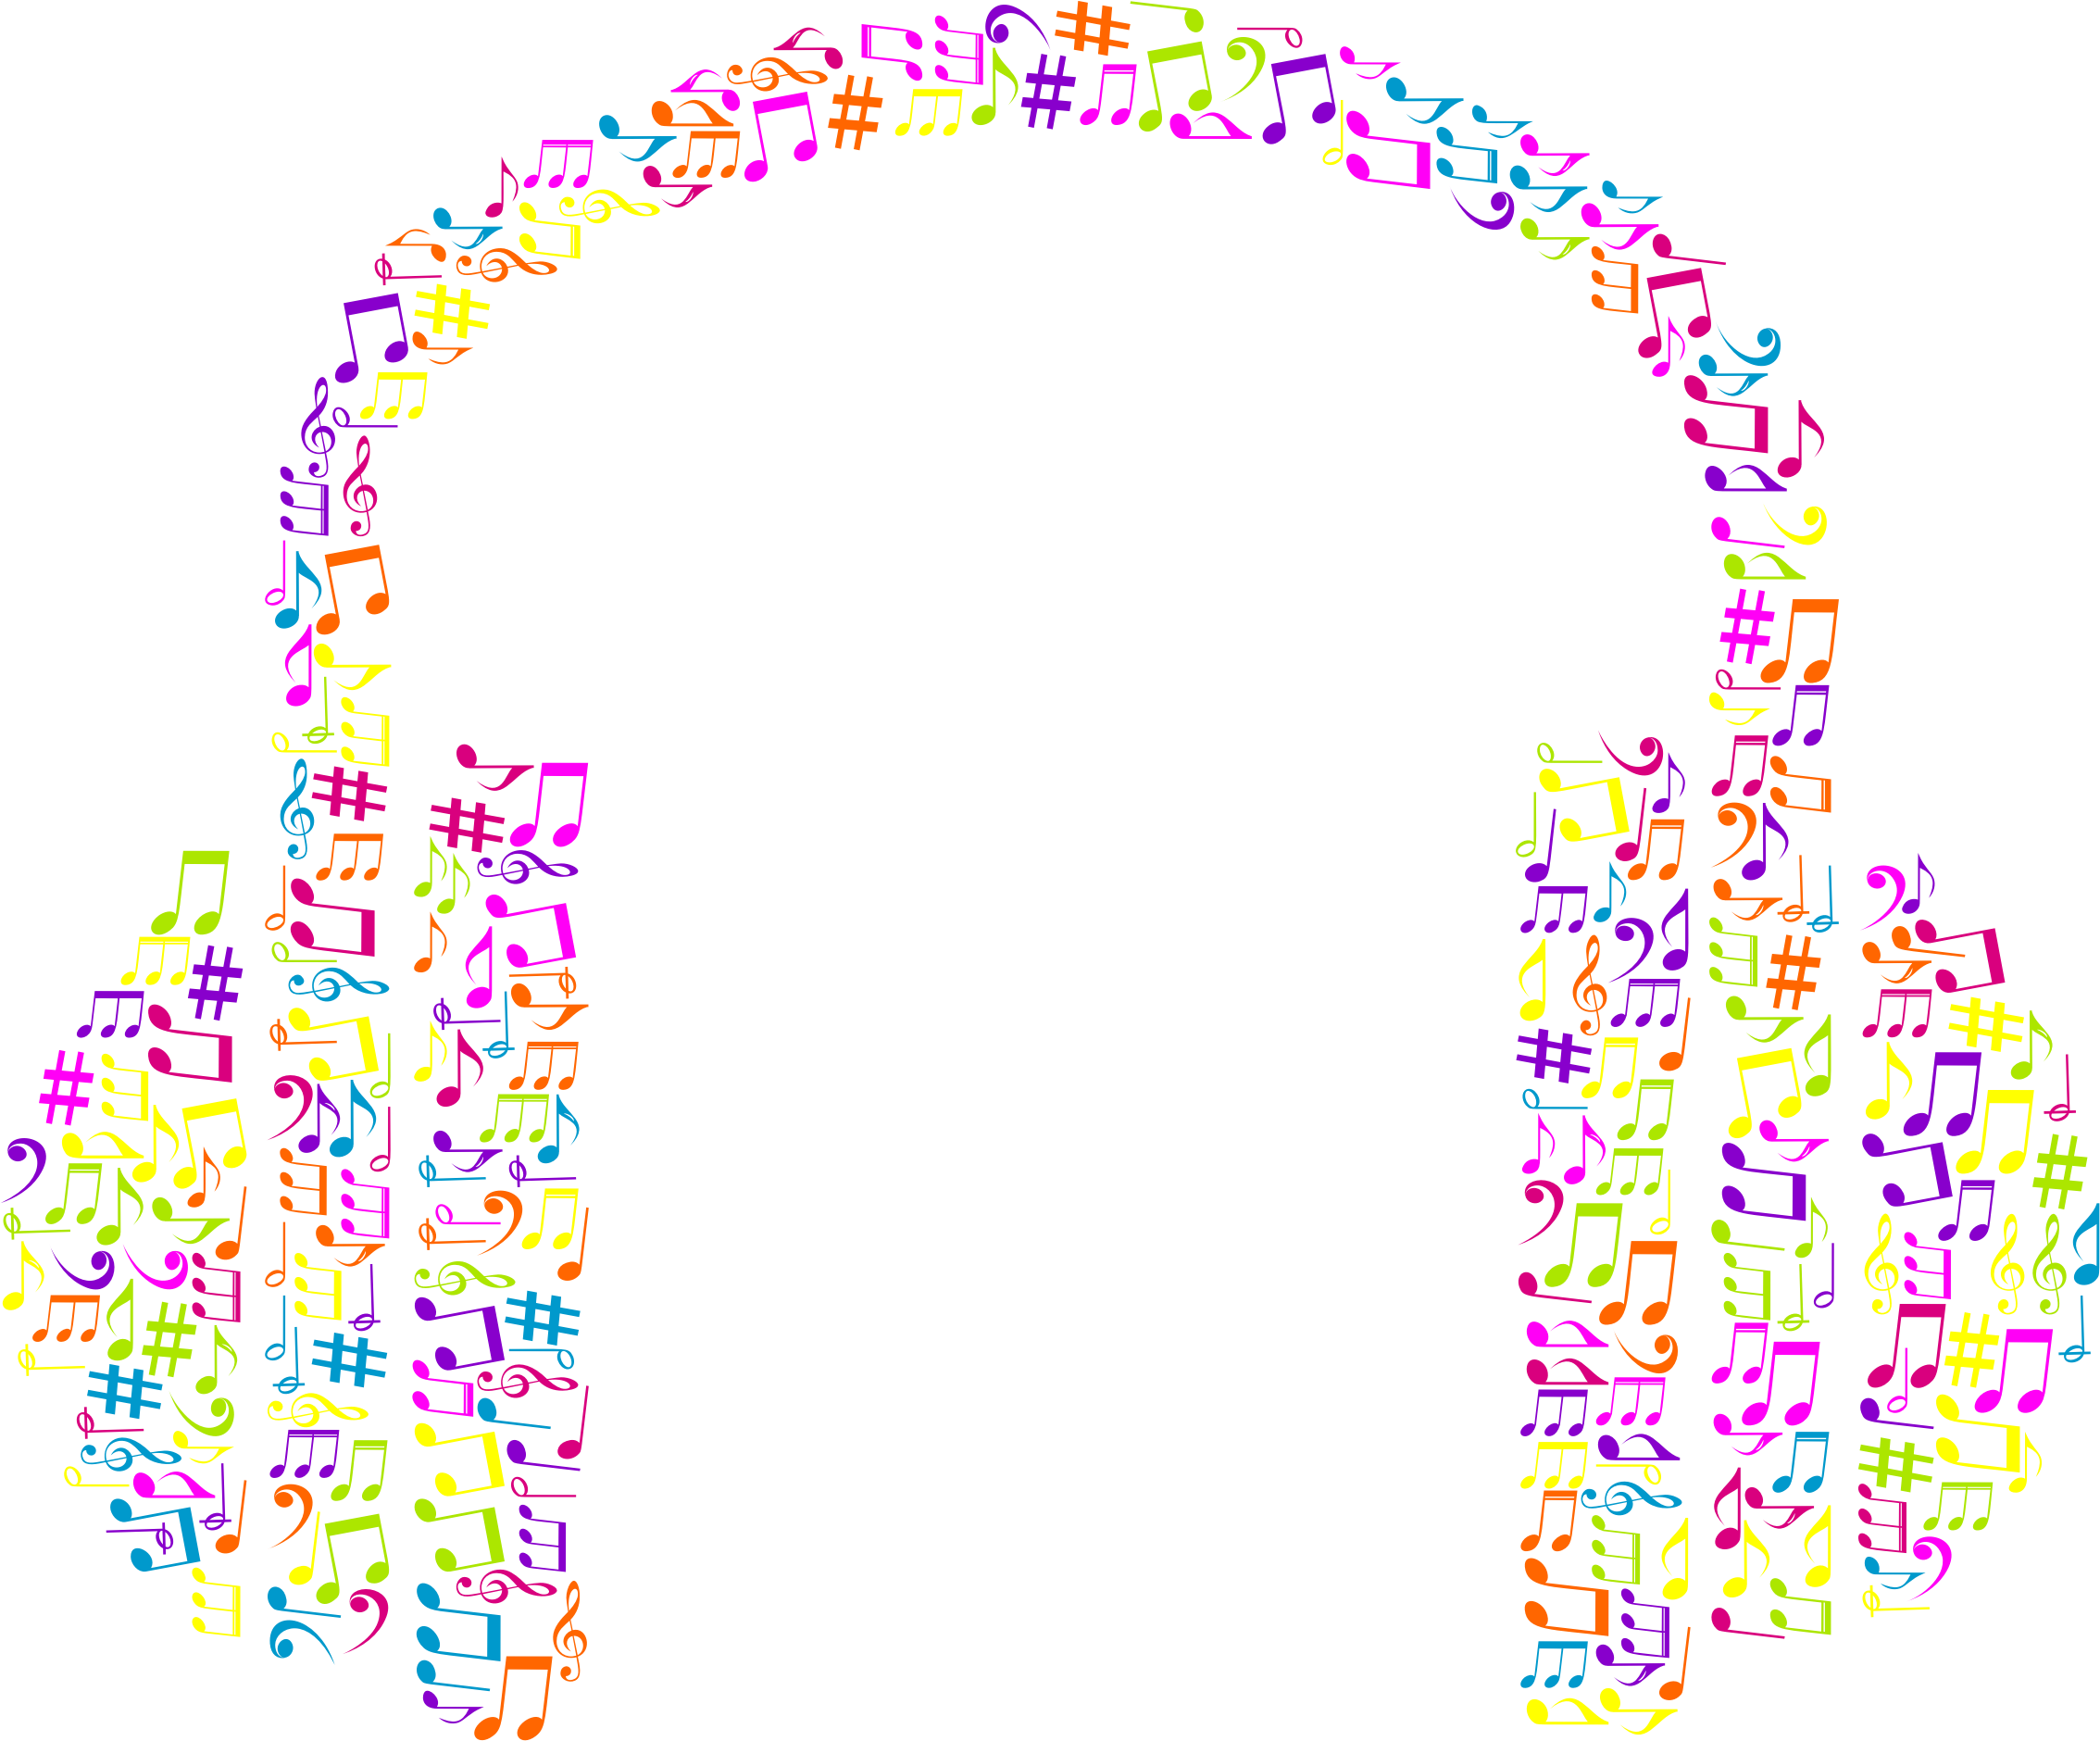
Application IDEA
Are you ready to play? Challenge your music knowledge with the simple, fun and fast game that you are going to be addicted to.
Try to recognize which song is being played every time.
In some stages of the game the artist is the one you try to find.
The game can be divided to the genres you pick.

Slide 3

GAME illustration: Main menu
Music Master-Menu
Start Game
High Scores Table
Exit

Slide 4
GAME illustration: genre choose
Music Master
Choose a genre:
Mix of all
Pop
Rock
Techno
…
Back to menu

Slide 5
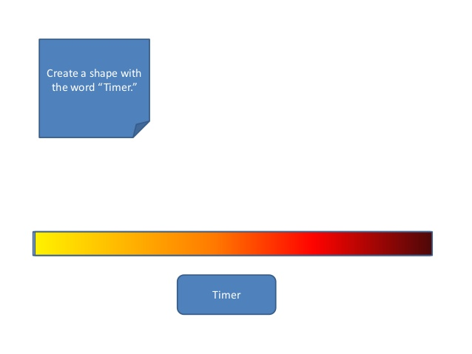
GAME illustration: Playing
Score: 2000
Guess song/artist
15 sec
Rihanna
Bruno Mars
Beyonce
Sia

Slide 6
DATA

